Slide 1
Use Git
Or any other version control system

Slide 2
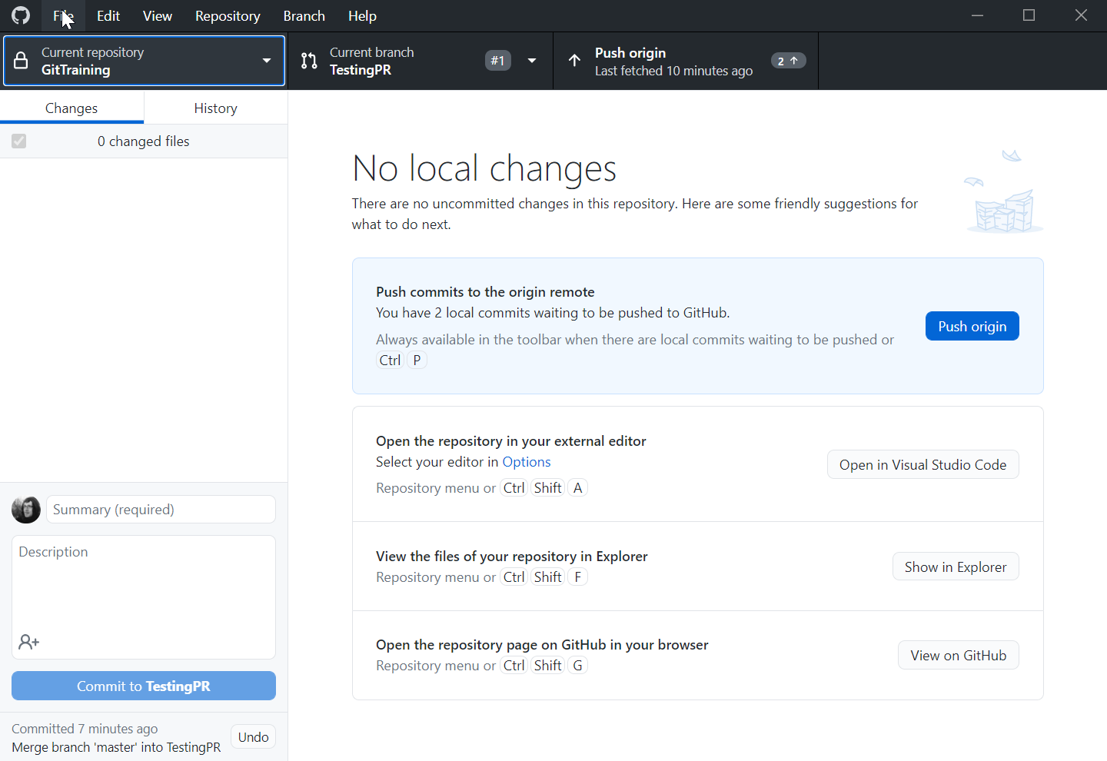
Got GitHub desktop?
https://desktop.github.com/
Simple and lightweight
Does not allow for all the Git complexity
(Or choose a client of your own)
Set up a GitHub account and sign in

Slide 3
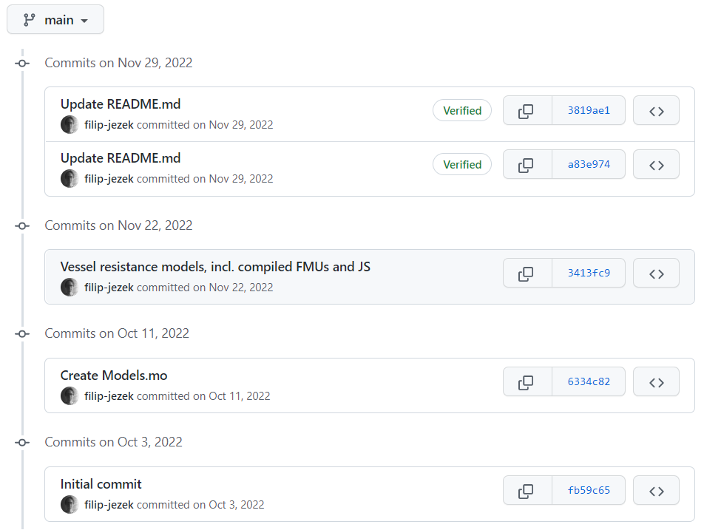
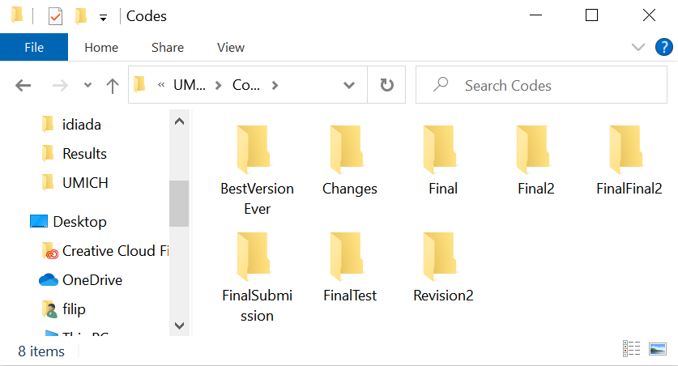
GIT: Get organized!

Slide 4
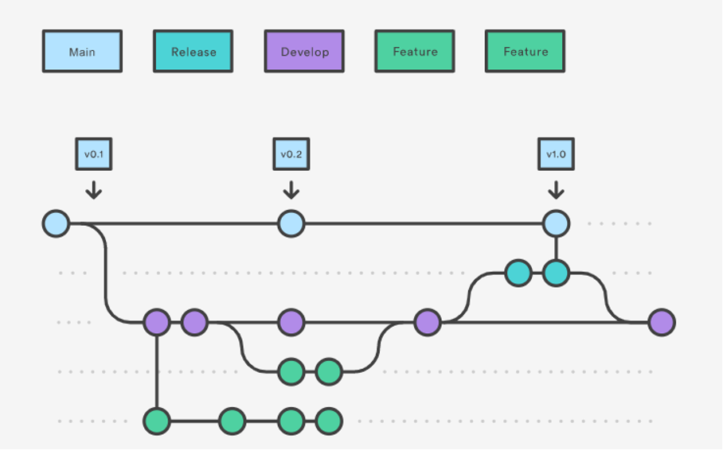
GIT: More versions of the same project
Hell to maintain?
Branches might merge back when successful, or die out

Slide 5


GIT: Get backed up!
GitHub:

Slide 6
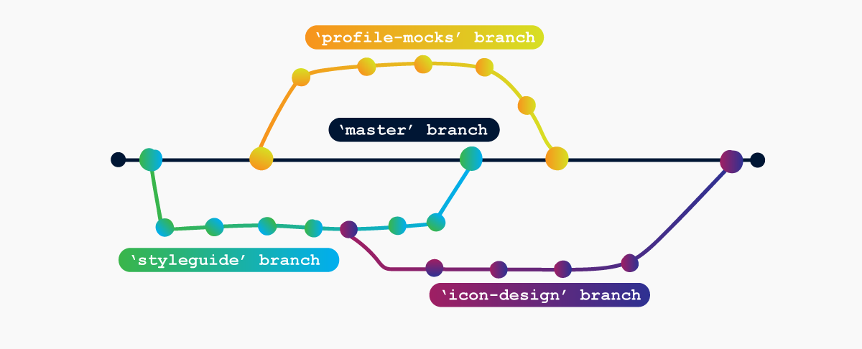
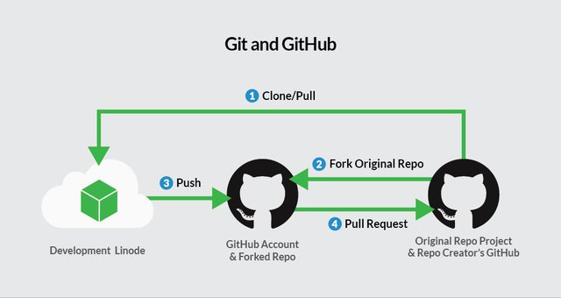
Git: Collaborate!
Invited collaborators
Pull requests from wide public

Slide 7
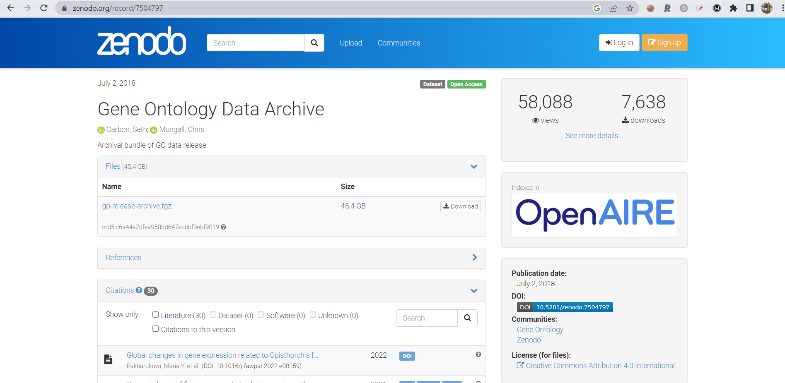
Git: Make your research public
A link to GitHub would do too
Dedicated storage repository - https://zenodo.org/

Slide 8
Version control system
Tracks all the revisions, creates safe „Checkpoints“
Allows organizing the project in multiple (concurrent) branches
Simplifies cooperation
Tag the release version and back it up!

Slide 9
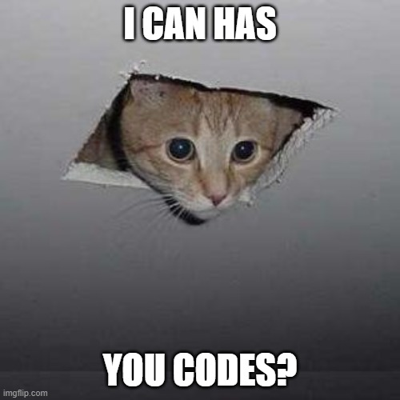
What to version control?
Anything plaintext, that you develop in time
Track your progress, tag a release
Public stuff vs Private stuff (GitHub)
Secret stuff? (GitLab)
Have codes? Make a repository!
Working on a codes? Commit and push!
“Publish only finished” vs A project is never final

Slide 10
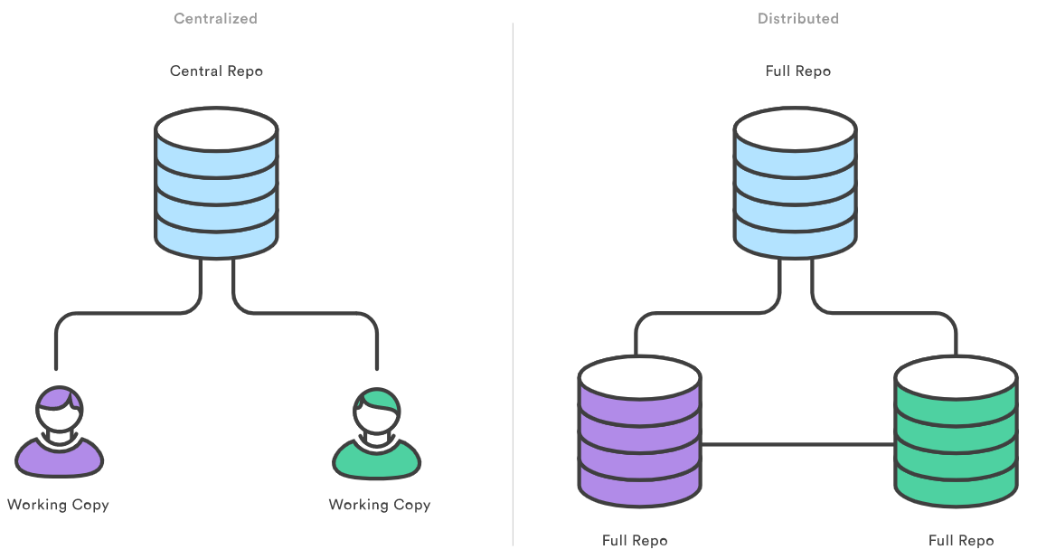



What is a Repository?
Repository: history and branches
Working copy: files on the drive
(usually in hidden subfolder, e.g. .Git)

Slide 11
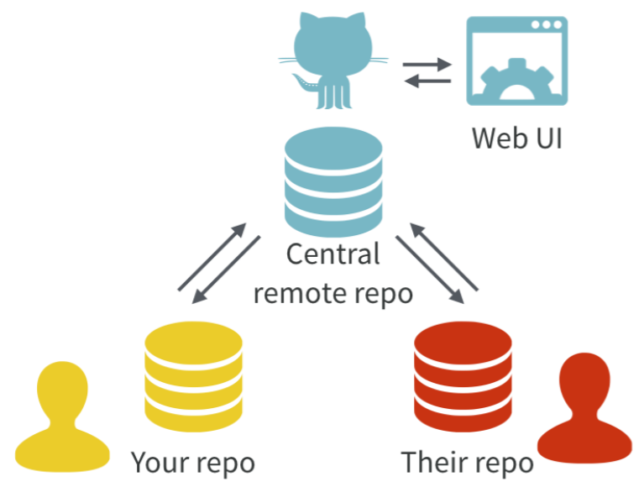
Centralized and distributed repositories and GitHub
Centralized repositories: All history on ONE place (CVS, SVN…)
Users pull working copies
Distributed repositories: Full history locally (local repositories)
Users synchronize their versions using pull / push
(Git, Mercurial…)
GitHub (GitLab) adds WebUI to the server
https://www.atlassian.com/git/tutorials/why-git
https://doi.org/10.7287/peerj.preprints.3159v2

Slide 12

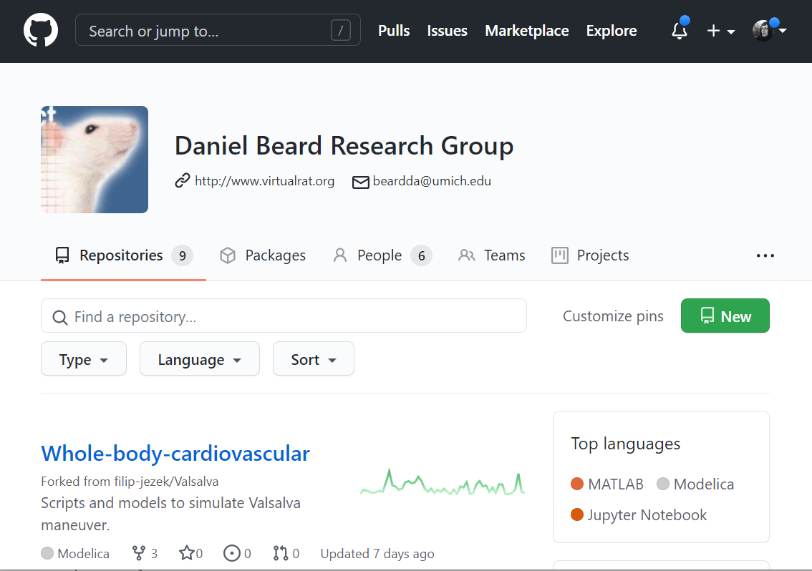
GitHub
A public, free git repository hosting (one of many)
Reliable, trusted, recently bought by Microsoft
Public repositories with unlimited collaborators
Limited private repositories
We already have https://github.com/beards-lab

Slide 13



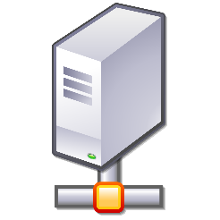

Process
DO THIS AS OFTEN AS POSSIBLE
File system
Local
Repository
Remote
Repository
Stage
Commit
Pull
Push
Do this for collaboration and backup

Slide 14
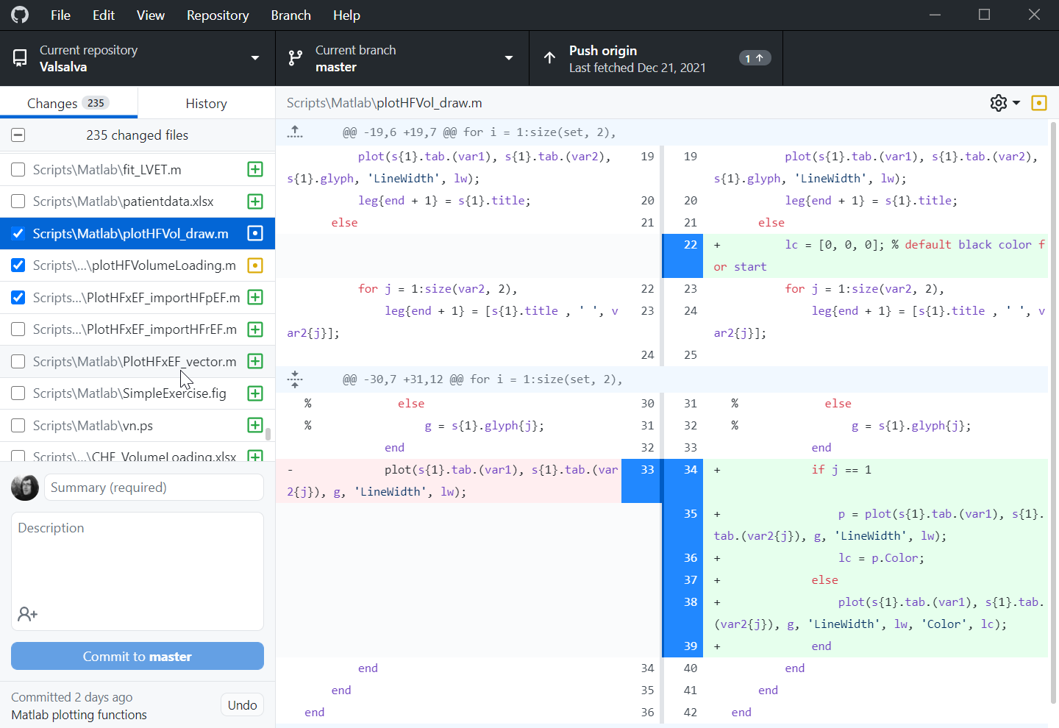
Process - stage
Selecting changes
Adding new files
Selecting changed files (or parts)

Slide 15
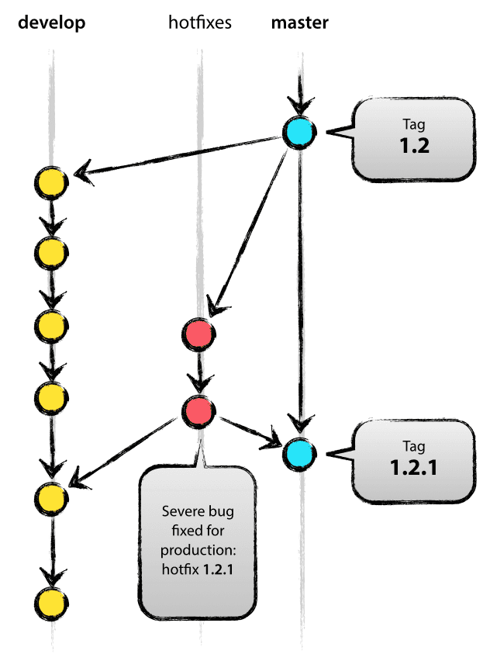
Process - COMMIT
Add a commit summary*
Commiting the changes into LOCAL repository
Safe checkpoint
On top of current BRANCH
Or to a NEW branch
Roll back to any previous commit
Compare with any previous commit

Slide 16
Process - PULL
Pulling from the REMOTE server into LOCAL repository
Could have more remotes
What if we made some changes?

Slide 17
Process - PUSH
Pushing our LOCAL repository to the REMOTE repository
Could have more remotes
What if the REMOTE version is newer?
Need to pull (aka fetch) first

Slide 18
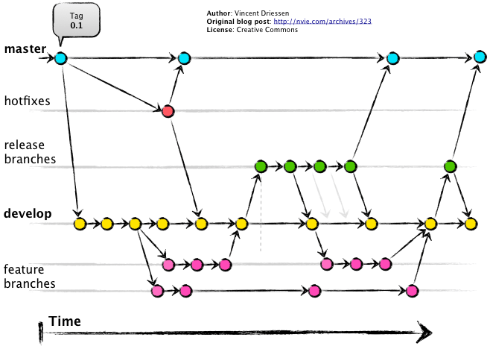
Branching
Each commit is a snapshot in time
Everything is checksummed with a SHA hash, with a custom label (commit name)
Has one or two parents
Branch is a pointer to a commit
Most recent commit in a branch
Default name: “master”, “main” or “CommitMcCommitFace:
Branches are meant to merge
Do not have to overuse with GitHub

Slide 19
Collaboration
Collaborators in your group share the same remote
Write access?
Outside collaborators for open-source project
Use GitHub’s pull request features:
Collaborator:
Makes a copy (Fork) of the repo
Commits his changes
Issues pull request
Maintainer:
Reviews and merges the changes

Slide 20
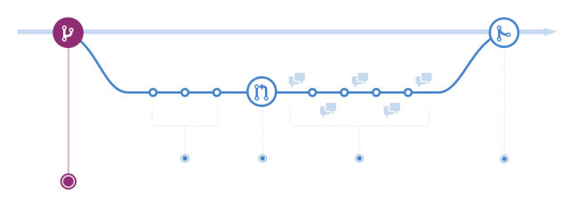
Pull requests
Open the code to wide public, incl. non-collaborators
Still prevent them from messing your code
“Hey, I fixed your code, wanna merge?”
You are sharing your code, Bob checks it out (forks).
Fork is Bobs version (= Bob’s branch)
Bob makes some changes and commits to his repository (which is a branch of your repository). Bob finalizes his codes.
Bob can’t rewrite your code, issues a pull request
You check his changes and merge

Slide 21
Hands on

Slide 22
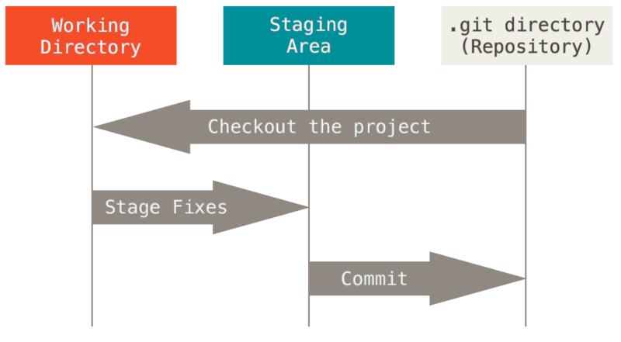
First commit, where we initialize
Initialize a new repository
Add a readme.md file, write down the “Hello world” line
Git commit
Staging level
Commit message
https://git-scm.com/book/en/v2

Slide 23
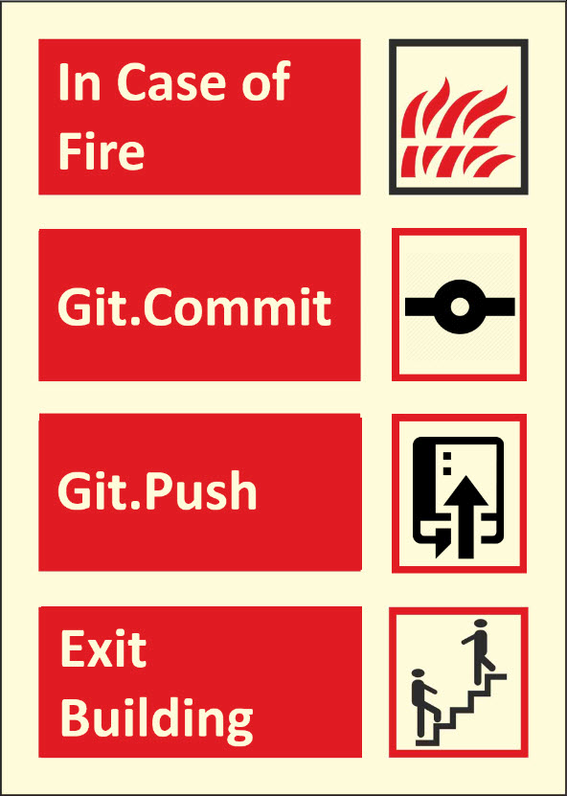
Second commit, where we extend and ignore
Add a line to the readme.md below the hello world: “This is our testing repository”
Add data/topsecretfile.md
Add generatedfile.mat
Add .gitignore file
Data/
*.mat
Commit
Push (publish)

Slide 24


.gitignore
Commit only the sources, not the products!
NO output and intermediate files
NO secret data not to be shared
=> Ignore staging
.gitignore
A specialized file stores what should be ignored at staging
also versioned, can be ignored :)
In any folder
Names: topsecretfile.txt
Wildcards: /*.mat
IGNORED FILES LIVE ONLY IN YOUR FOLDER
NO DISCARD
NO REVERT
NO CONTROL ON BRANCH SWITCH

Slide 25
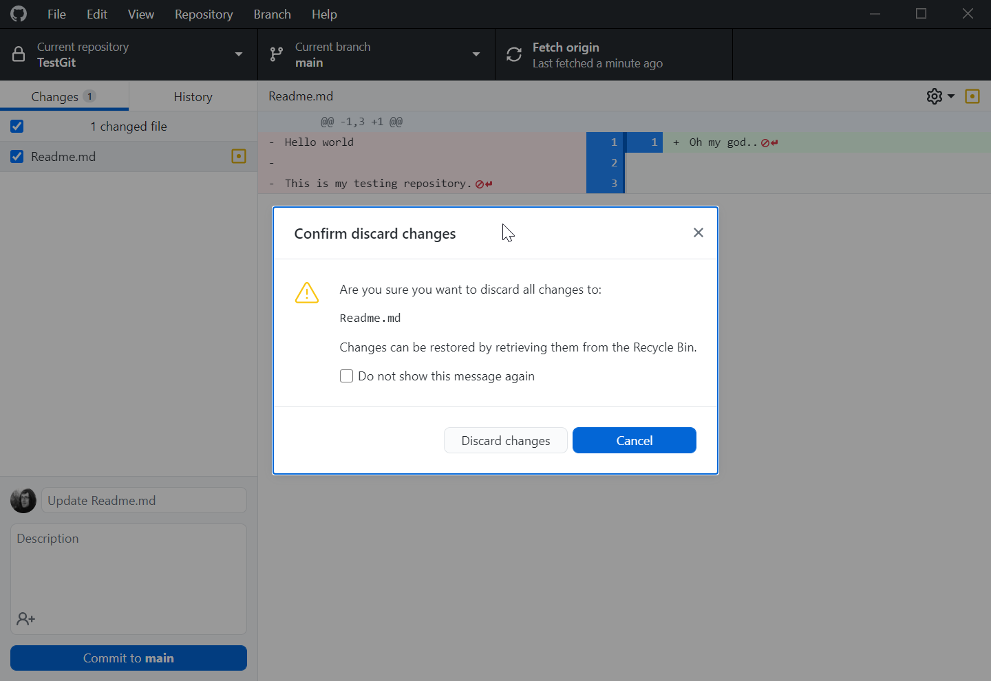
Third commit, where we mess up
Delete the content of the readme.md
Revert
Mess up again and commit
Undo commit (if it was not pushed)
The files stay modified
Reset to… (if it was not pushed)
The files get reset too
Push
Revert the commit (not always possible)
View file on GitHub to get previous version (always there)
Make a branch on previous commit (Full working state)

Slide 26
That’s it!
… let’s see some advanced stuff with branching!

Slide 27
Fourth commit to a new branch
Create branch from last “working” commit, name e.g. main-2
Add some wisdom, commit and publish branch
Switch between branches – the file changes too!
And so is the whole repository
AKA git checkout

Slide 28
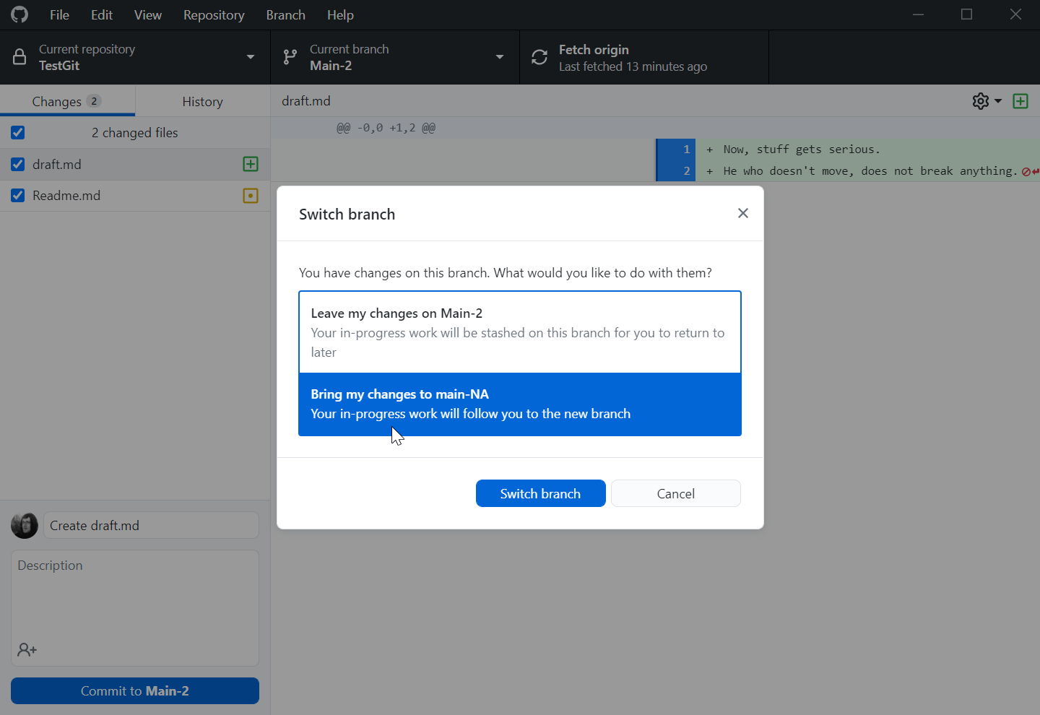
Fifth commit, where we experiment
We want to experiment without the wisdom
Change the “Hello World” to “Hello North America”
Rightclick on “Second commit” – create Branch from commit
Lets move our changes along
(stash is just a local commit with reset)
Let’s call the branch “Main-NA”

Slide 29
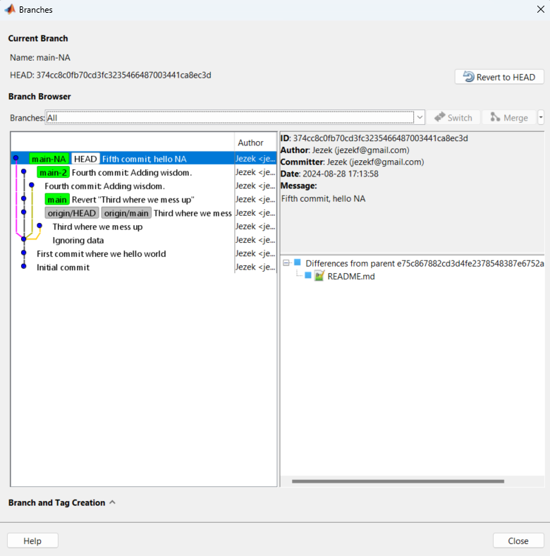
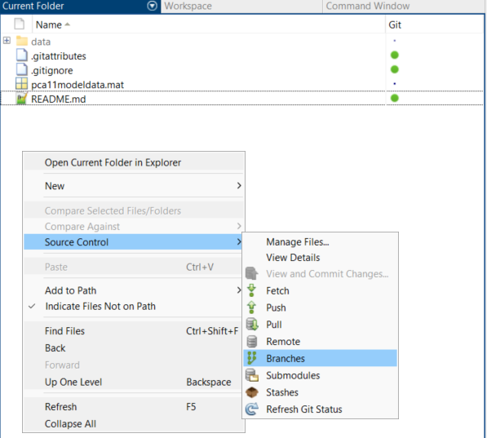
Let’s use Matlab to see the branches
Navigate to the folder in Matlab
Right-click – Source control - Branches

Slide 30
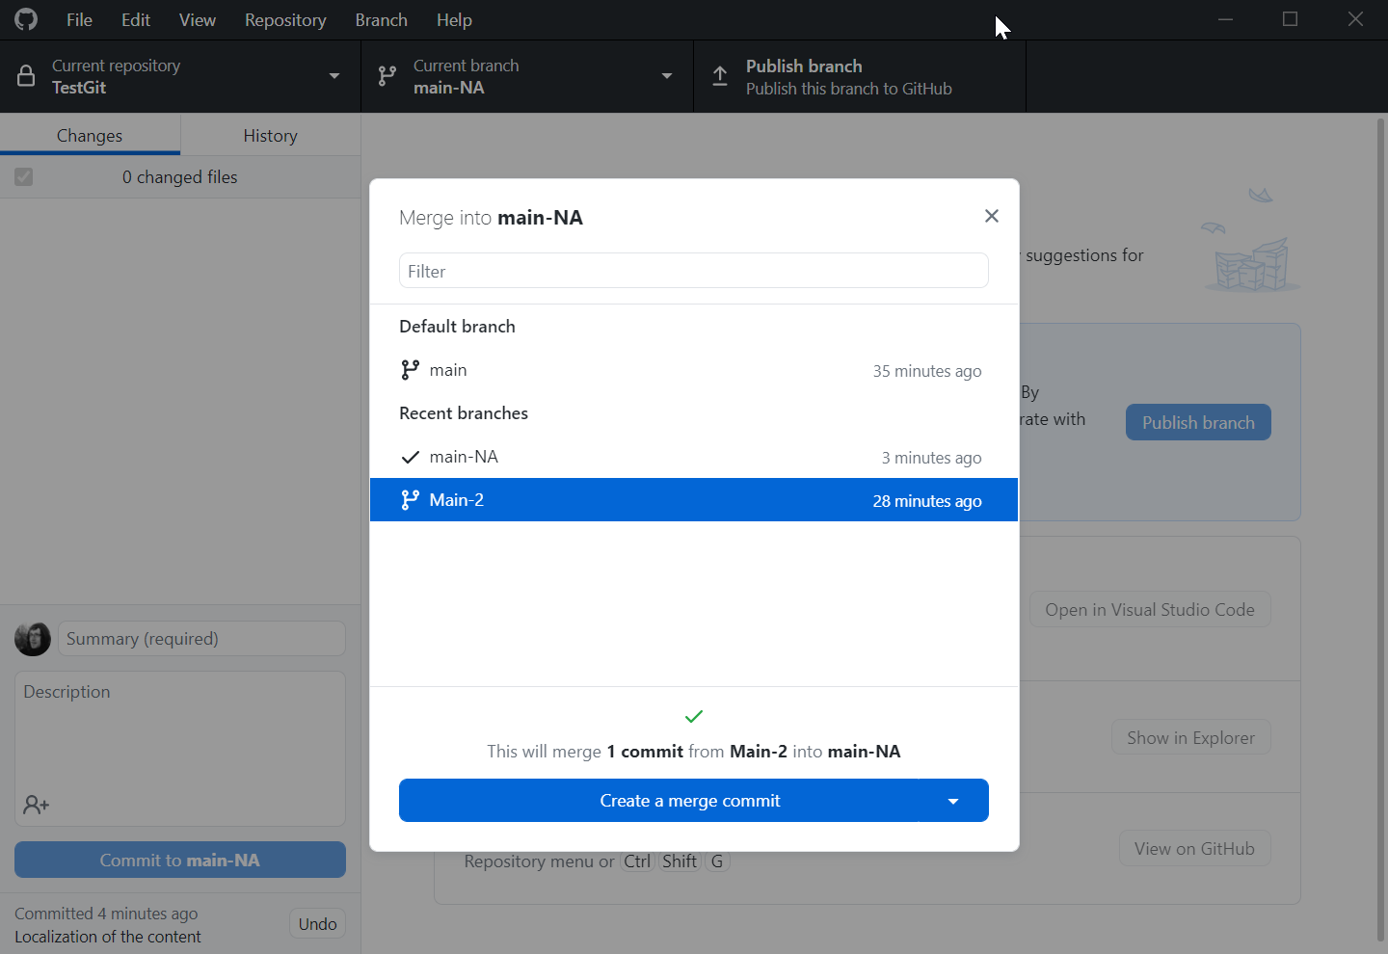
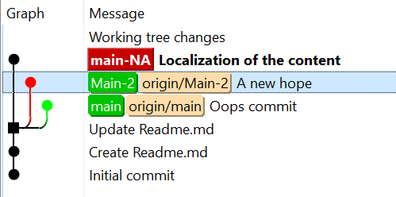
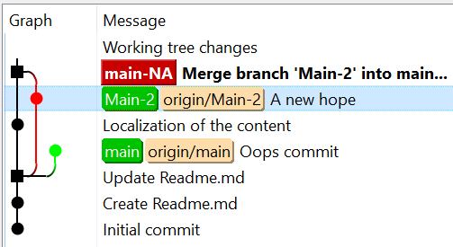
Sixth commit, where we merge
We want the wisdom back after all
Branch – merge into main-NA
Select main-2

Slide 31
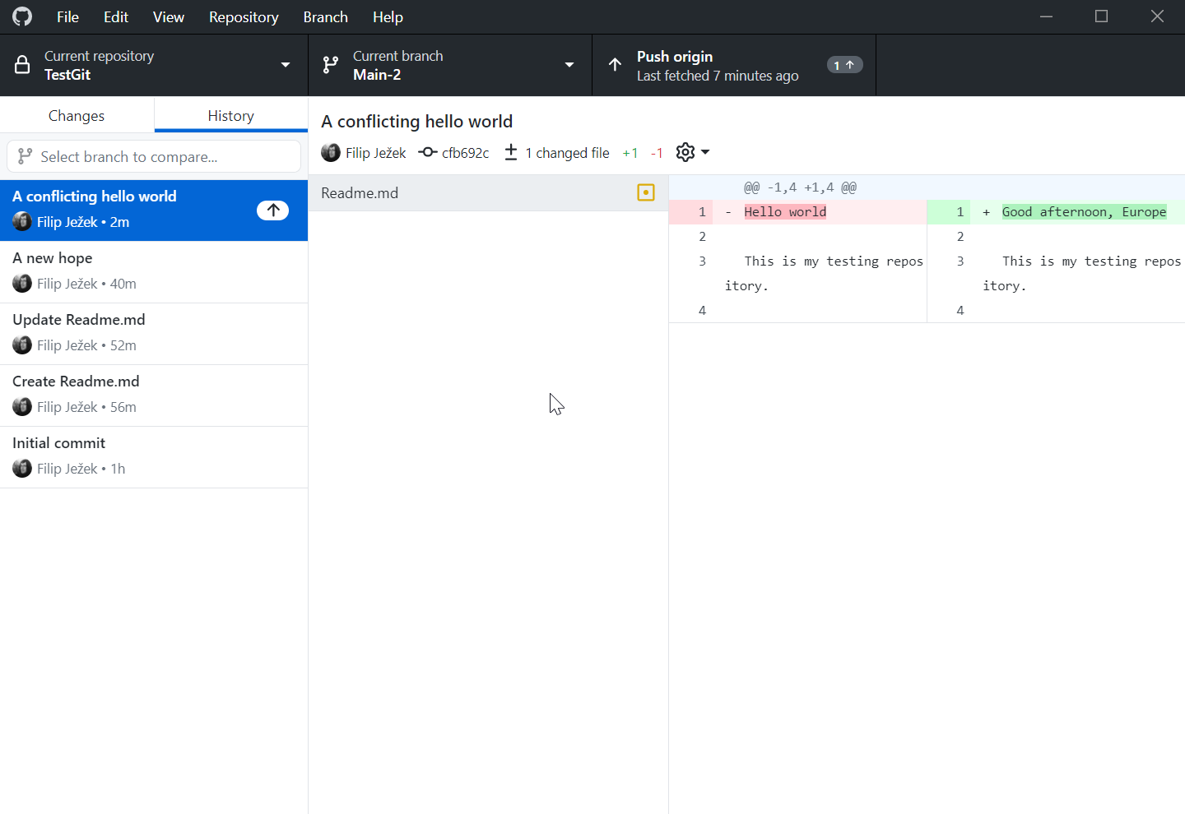
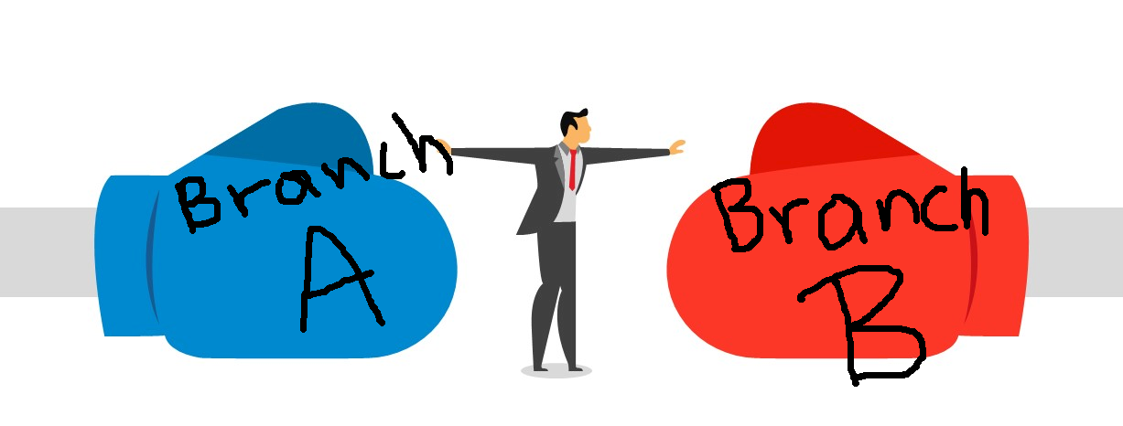
Seventh commit, where we create conflict
We continue main development, for some reason
Switch to main-2
Edit “Hello world” to “Good afternoon, Europe”
Commit
(Concurrent changes, not just addition)

Slide 32
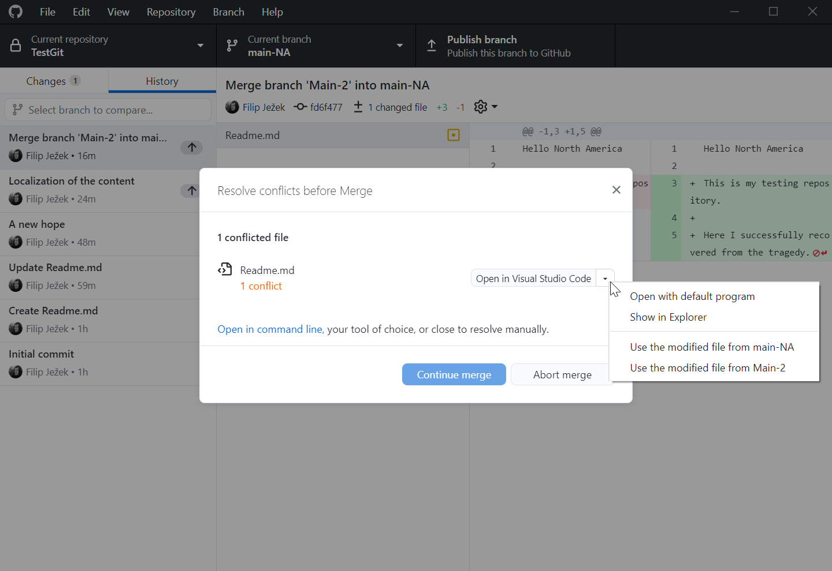
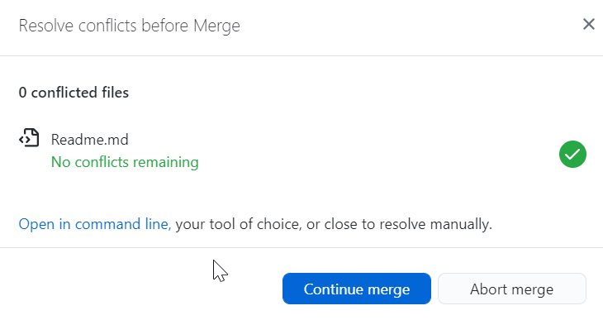
Eighth commit, where we resolve
We want update our experimental branch
Now, switch to main-NA
Merge main-2 to main-NA
<<<<<<< HEAD
Hello North America
=======
Good afternoon, Europe
>>>>>>> Main-2
Resolve as e.g. “Hello Europe and North America”
Use specialized tools to help resolving
(e.g. Matlab or VS Code)

Slide 33
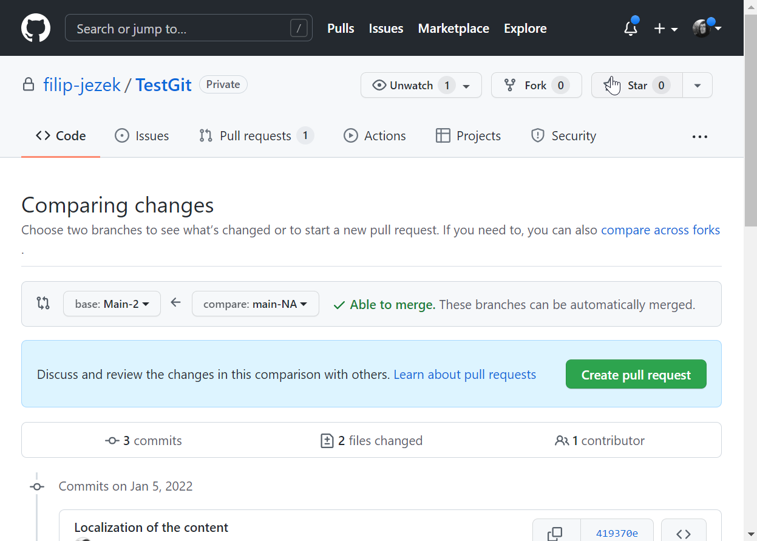
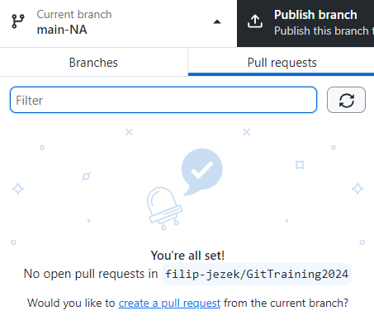
Create a pull request
Now, our main-NA is new and even, better everywhere
Demonstration of the GitHub way - We ASK to merge our main-NA changes into main
Create a pull request from GH Desktop…
Or Publish and push everything, Navigate to GitHub.com – create pull request
No conflicts, already newer
DO NOT MERGE YET

Slide 34
Ninth commit – updating a pull request
Pull request is to merge a whole branch
Thus, if we modify the branch, the pull request is extended
Add another wisdom
Commit
PUSH

Slide 35
Tenth commit is an assignment
Clone https://github.com/beards-lab/Phys520
Create a initials_your-nick-name.md into the 01_GitTutorial folder
E.g. FJ_jez.md
Write down what you
1) like about GitHub
2) dislike about GitHub
3) At least one question
Commit, push, issue a pull request
Bonus: Retrieve a hidden message from the repository

Slide 36
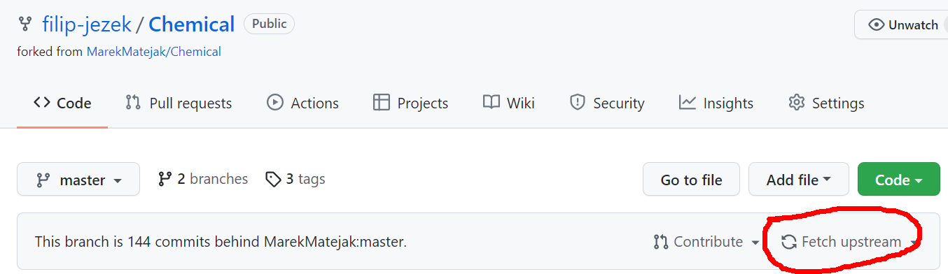
Check-out a repos
File – Clone Repository - URL
Remember to keep your fork in sync!
Branch – merge into current – upstream/master
… or

Slide 37
Beyond the basics

Slide 38
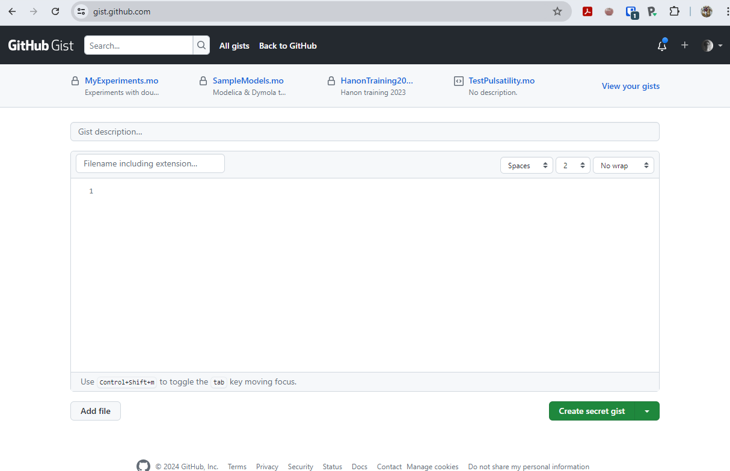
Gist
GitHub service
Fast sharing of code snippets – just send a link
Everything is git-versioned

Slide 39
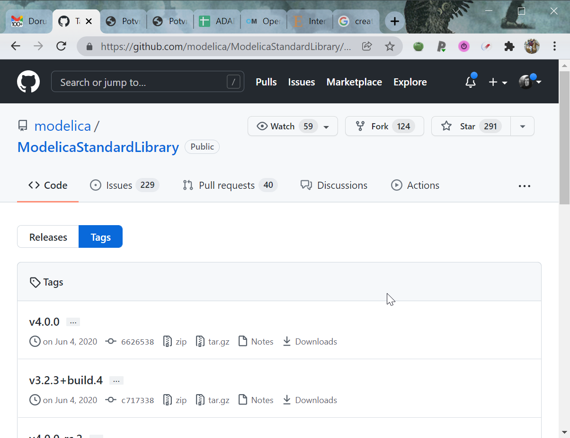
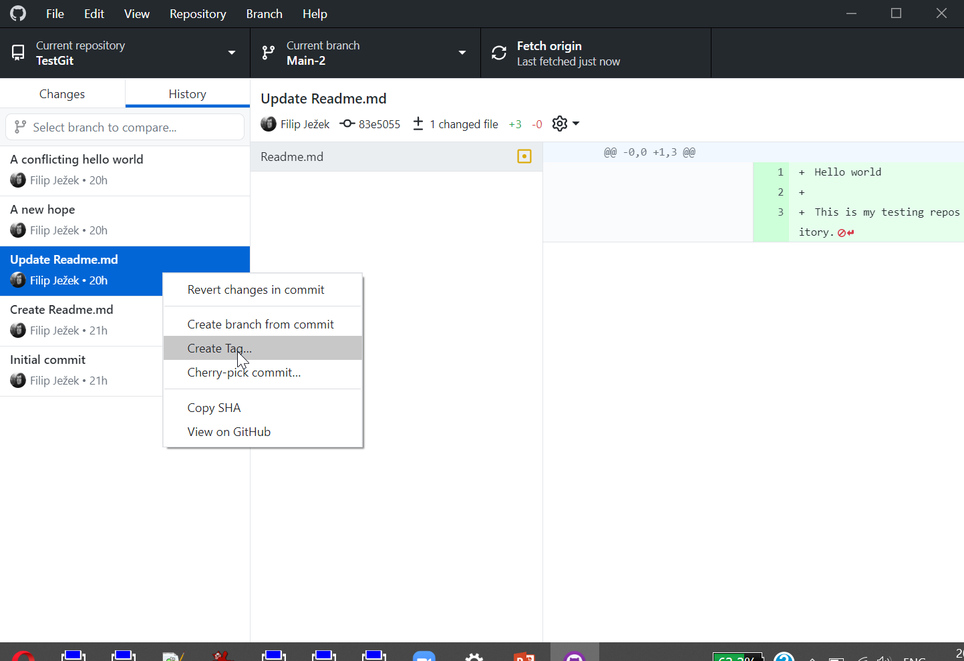
Tags, releases
An “immutable” pointers in time
You release a paper, you submit a thesis – Tag it!

Slide 40
GitHub
GitHub is more than a source code repository
GitHub Desktop allows only basic workflow
Some functionality of GitHubDesktop taken over to GitHub web itself

Slide 41
Tidy up
Squish commits into one
Make default (e.g. “main”) branch
Add Readme.md
Format the .md files with markdown
Add a license
Maintain .gitignore

Slide 42
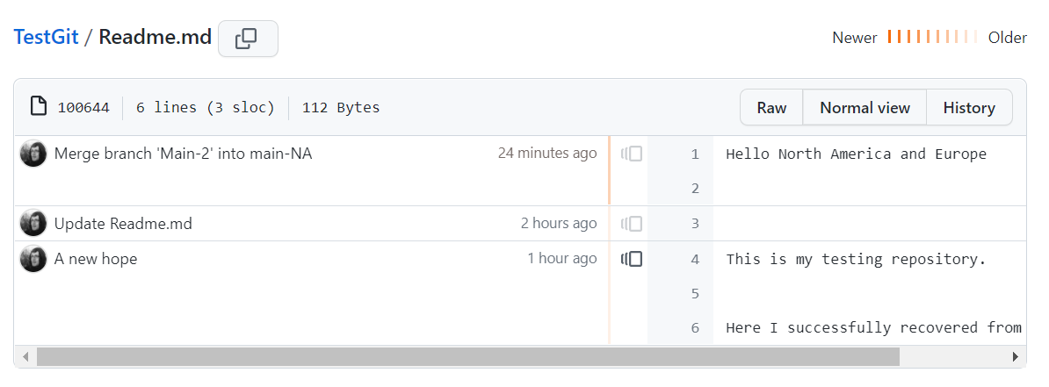
Git blame
Show what line comes from which commit
Handy when debugging history
Navigate to a file in GitHub, select blame

Slide 43
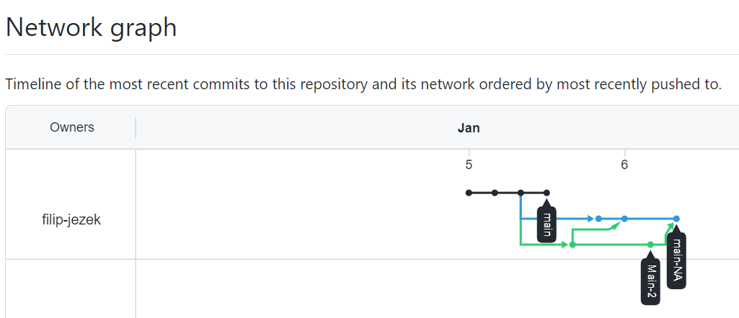
Reflog
Replaced by /network in GitHub
Only for public repositories

Slide 44
GitHub pages
Free hosting
Based on static pages, generated on each commit
E.g. https://filip-jezek.github.io/

Slide 45
More resources
https://www.coursera.org/learn/introduction-git-github
A free in-depth GitHub course, provided by Google
https://git-scm.com/book/en/v2
Beginner to expert guide
https://docs.github.com/en/desktop
GitHub Desktop documentation
https://docs.github.com/en
GitHub docs

Slide 46
Questions

Slide 47
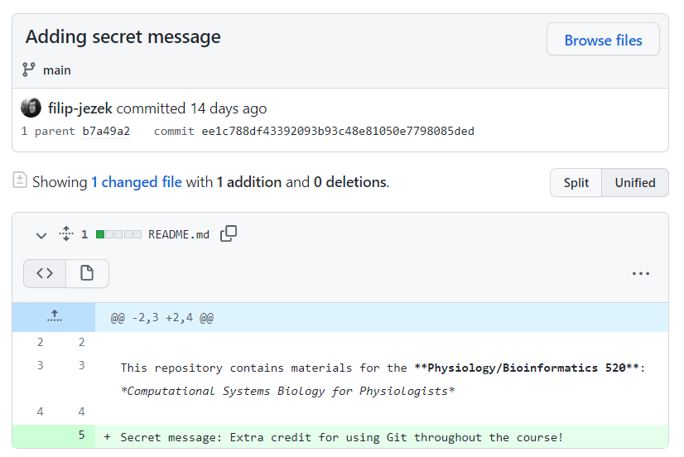
Hidden message
See commit history or file blame
Takeaway: Everything that you commit and push CAN be found.
No need to be afraid of mistakes
but be careful with any secret / private data!

Slide 48
Merging and Conflicts
If you make a branch and are working on adding a section of code in the middle of your original code and you want to merge, will you have a merge error? Or is there a way to shift down lines of you original code? That way your new code will be inserted in the proper location without replacing any original code.
I was demonstrating just an edge case, where we were editing the same line, thus the Git cant really decide what is better. But for a simple additions inbetween existing codes, the Git merges automatically.
sometimes it shows ”conflict” and couldn’t merge. What kind of things are conflicted to each other?
Conflict may happen during merging branches, when it can't be resolved automatically, that is when the same line has been edited on both branches and Git can't decide what should be kept. Otherwise all simple additions and deletes are applied (merged automatically). When files are conflicted, we have to resolve the conflicts before copmleting the merge. So, you could merge conflicts, you just have to oversee the operation and help the Git a bit.
Is there a way to make sure that no one else is working on the same file as you to avoid a merge error?
No tools will ever eradicate the need to communicate within the team.
make sure you commit and push as often as possible. Thus, your collague would have a most up-to date version, avoiding conflicts.
Split up the work, so it is not probable to overlap and finally,
do not be afraid of conflicts
Can you merge repositories? Would duplicated file names (such as a readme file) cause conflict if you can merge repositories?
They could merge if they had same parent at some point (e.g. fork). From that point, same files would cause conflicts.
But it would be easier to just add the files to one of them and resolve manually. KISS!
Is it possible to unmerge branches after the merged branches have been pushed?
You can revert the Merge commit – this will revert the changes, but the branches are already merged. You can still switch to the other branch and continue there or start AGAIN from the point BEFORE you merged.

Slide 49
Git tooling
Do we have to edit files that we save in our directory or can we make changes straight from our github account?
Actually, both is possible. To make some simple edits to e.g. readme file, it is totally fine to use the web interface. However, if you are programming python or matlab, and you already should be, you better use your local folder. This way you can see all your changes in the staging window, ready to commit (or roll back). Uploading your files from time to time is definitely not recommended (although better than nothing I guess). If you made some changes through github.com though, your Git client wont allow to **push** untill you **pull** all newer changes back to your local repository. This way it prevents any potential conflicts in the remote repository.
What is the name for the subject that stores many repos together? For example, in the github for the R package tidyverse, https://github.com/tidyverse, there are many repos belong to this page. Is this page a repo itself?
it is called organization. Organization could have a number of public or private repositories, similar to what an individual could have. See the difference in beards-lab: It unifies the collective effort under one brand, the commits are done by individuals (the team) though. You could have unlimited team members here so everyone could write access any of organizational repositories (or a subset of), as long as the organization and its repositories are public. For private repositories and organization you have to start paying to GitHub
for an average programmer, how much GitHub expeirnce do I need?
The more the better :) Start using it on regular basis. Committing everyday, rolling back every week, being able to get a previous version, branching or merging once a month and doing some serious complicated operation once a year would take imho five years to get you fully professional. Concentrate on doing your job and use git just as you use an elevator - you usually just need to go to your fifth floor and back, thats about it. But if you are moving furniture, it comes really handy and I am pretty confident you will find a way when the need arises.
What other tools are there in Github?
It is a large ecosystem – Issue tracker with project management (i.e. kanban cards) wiki, GitHub pages (statically generated through Jekyll), continuous integration – hooks on commits, e.g. compiling, running tests etc

Slide 50
.GitIgnore
I am using MacOS, is there any way to get rid of the .DS_store file that persists in my 'changes' to commit? I have already chosen to send it to the .gitignore file, but it did not fix the problem.
- adding .DS_store into .gitignore should do the trick. I have just updated the .gitignore, try pulling from **"upstream"** or fetching your github.com repository to match the upstream.
If I edit the gitignore file, I make some file visible and not visible. Why you said it was not reversible?
Once committed, the file would always get change-tracked. You can delete it from the repo, commit and copy back – now it can be ignored and not tracked

Slide 51
Pull requests
How do I resolve conflicts in pull requests when working with a team?
The maintainer needs to resolve that, usually by noticing the issuer to merge the updated version and resolve himself
Can I request a pull for several files I changed together or I need to do it one by one?
- the pull request is actually a merge of your whole branch. So whatever you do in YOUR fork (your copy of my repository), be it one or dozen new files, edits and deletes, is contained in your pull request.
What is the social ettiquite for submiting bug fixes and edits to someone else's code in a shared project (so as not to be disrespectful).
1. Do not be a jerk. 2. Publicly listing an issue / pull request / feature request is way better than emailing/contacting separately the author to do this and that and that you have found a major flaw / issue, feature request. People usually maintain their project through GH already, so do not cross the system. 3. IF your motivation is to contribute to the project and make it better, go ahead and fear not.

Slide 52
Publishing issues
Is it alright to publish code that other people have contributed to?
Yes, as long as you respect the licence. Most of the repositories published at GitHub do have a licence file. This is mostly MIT (use as you want, even for commercial use) or variants of GNU licence. If someone contributes to your repository, she has to be comfortable with that license. On the other hand, you should acknowledge his co-authorship. - if you have some code that you worked on together with other people, you probably should agree on a licence of their contribution - be it MIT, GNU, some proprietary one or not to share at all.
Do tags exist only in GitHub, or are they a feature of git repositories (whether they are managed in GitHub or not)?
It is a general feature. You can right-click any commit in GH-Destkop and select Create Tag. Remember, that whatever you can do with **GitHub Desktop** (not using any web features), you can also do with ANY other git client (and usually more). Tag is just a pointer on a specific commit, immutable in time. Github.com then presents all the tags and releases nice and pretty.
Can you share a private repository (without making it public for everyone)?
Sure! GitHub provides to add a collaborators to private repositories. You can have private repositories under institutional pages (e.g. beards-lab), which are accessible for the team only.
Can anyone clone my respository? How do I set permissions on who can access code I push to Github?
YES! That is the point! If you do not want to share, just set the repo to private. Once private, you can manage who gets the access.
I don't love the idea of 1 mistake with private information could result in major major problems due to how repositories work and being on various machines.
You also do not let your credit card circle around - you simply do not put private info in the shared folder.
I am able to access the assignment repository, but is just anyone able to? Is posting to GitHub the making public part and anything that should be private is on the local?
Yes, since it is public. The private then is not seen by anyone. Forking something public makes it public too (can be reset in settings).

Slide 53
Other
Why does git command line exist if github desktop is a thing?
- *First, Git comes from the Unix people. They love command line. They might die without touching the keyboard regularly :) Most of the git tools are just a GUI on top of these commands. Second, it is often used in the help files, because that is the right way to do, regardless in which menu item or under which name it is hidden in different git clients. GitHub desktop is only one of such clients. I personally find nice, that all the commands are somwhat hidden from us. You can however grab any other tool to use with Git or GitHub.*
Can I write into files within a repository from the command line?
- *Something like https://superuser.com/questions/186857/how-do-i-edit-text-files-in-the-windows-command-prompt ? The repository is basically your local folder. Or you meant accessing the history, commiting, pushing, and all that stuff? The Git has been designed for command line, but I am no expert on the commands. The https://git-scm.com/docs/ should have your back. But unless you are a big nerd {no offence), you are just fine to stick to any GUI tool you like (the GitHub desktop is possibly the simplest and most user-friendly one). You can of course edit your files directly in the github.com, but this is really impractical (that is, do not do it!) for your source codes.*
Can two repositories be merged? I'm not sure why this would have to happen, but I'm curious.
Yes, though it is quite an extreme case. You can have more than one "origin" sources. But this is impractical and could do more harm than good.
Is there a size limit to the repository?
individual files should not be larger than 50 MB and the whole repository is recommended to be less than 5GB, which is fine even for large projects, as long as you don't commit binaries

Slide 54
Other
What will happen if I use ```--force``` option in ```git push```?
Usually nothing. The force option is to override the otherwise forbidden pushes – like pushing when not the last commit, pushing rebased branch etc.
I think that as files grow bigger and there are more changes, it would get really complex to navigate branches and file versions. I'm worried about how that will work with other collaborators as well.
The history is usually linear. Once the branches merge, it gets linear again. No big deal, honestly. To orientate better, create releases and tags.
Is it true that we can only have .gitattribute under the root of the repository?
You can have as many as you want. But only the one is used to define the settings.
Settings can include various stuff like line endings (CRLF / LF), what to consider as binaries and other next-level repository level settings.
How does using "git fetch upstream" help in keeping a forked repository up-to-date with the original repository, and what steps should follow to integrate the fetched changes into your local branch?
This will synchronize your fork with the parent, upstream repository. Imagine I have added new content AFTER you forked – it would not get updated automatically, you have to fetch upstream.
Will there only be one administrator for each repository?
There can be more, for sure!

Slide 55

Take away
Use Git & Commit!
Push sometimes
Ask for more
KEEP IT SIMPLE!
Commit!
Do not overuse branches

Slide 56
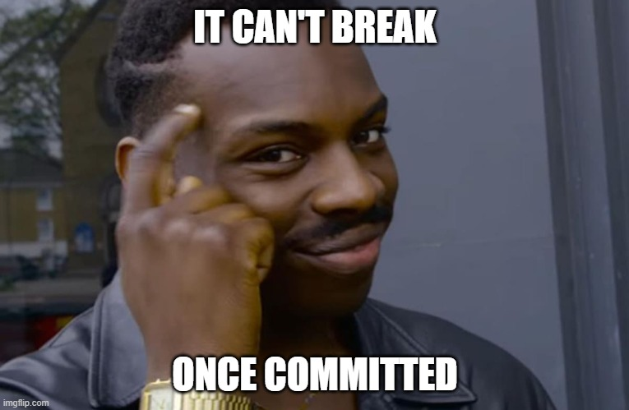
More help
Filip Ježek
fjezek@umich.edu

